Slide 1
McCall Outdoor Science School (MOSS)
Lowell MOSS Experience
January 29-Feb 1, 2018

Slide 2
4 Day Experience
Leave Monday morning on January 29 (school bus)
Return Thursday afternoon on February 1 (school bus)
Hands on Experience with Science
Develop Hypothesis
Conduct Experiments
Aligned to Science Standards and Common Core
Fun, Fun, Fun!

Slide 3
Photos
Shared from other Elementary School’s
in Boise School District

Slide 4
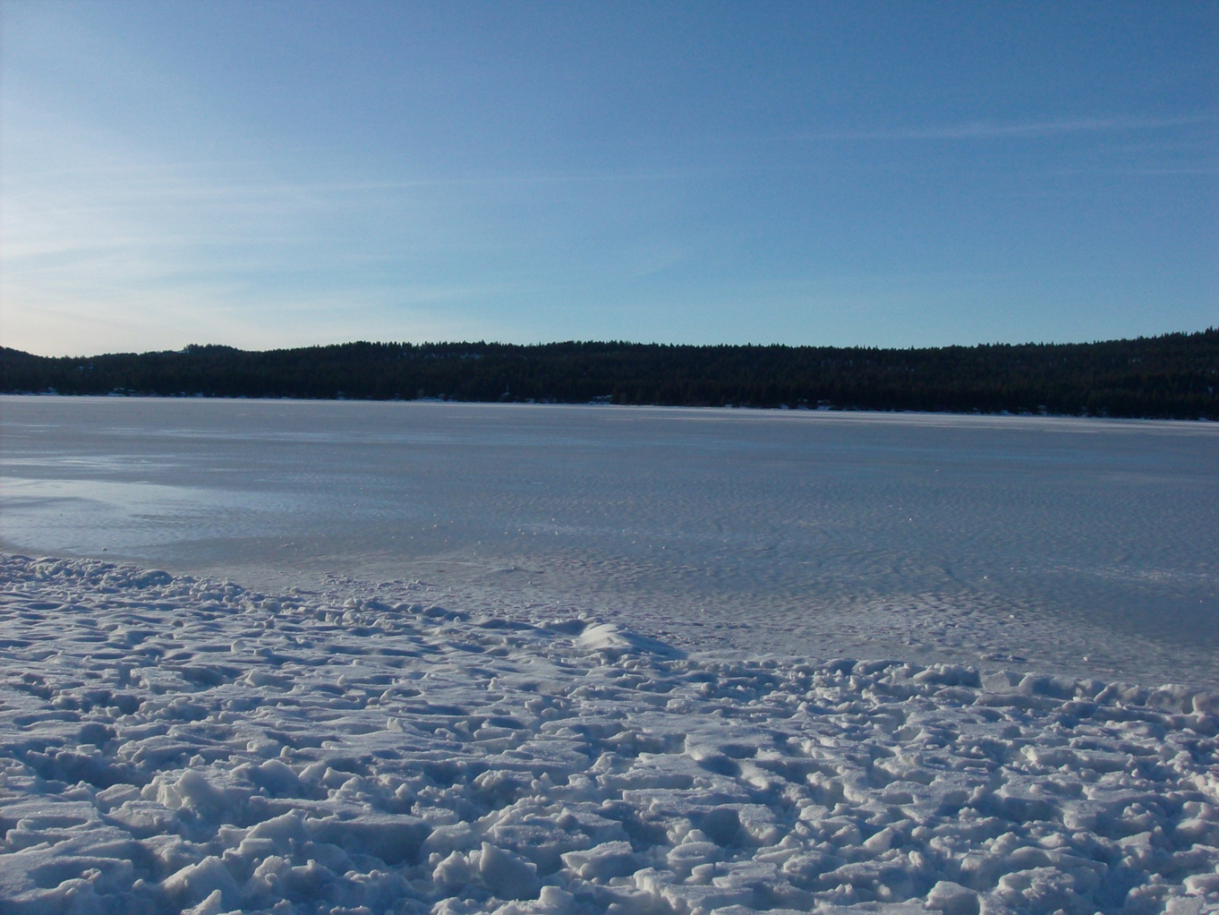

Slide 5
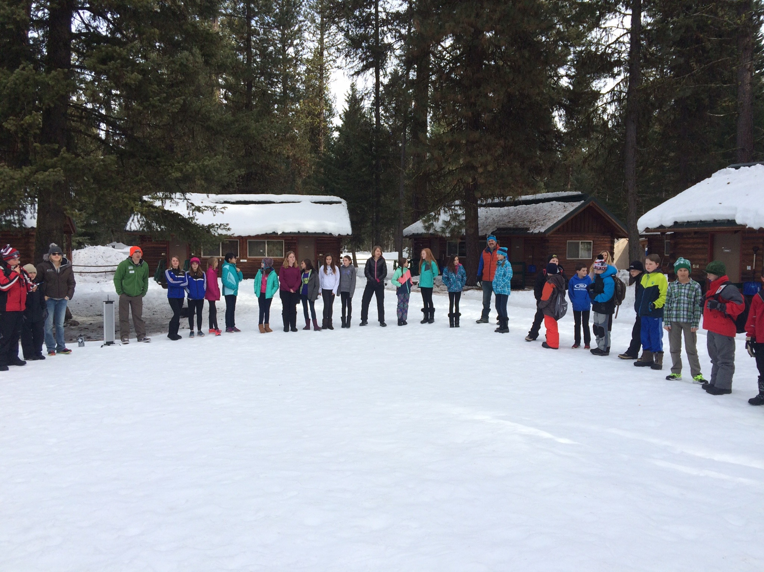

Slide 6
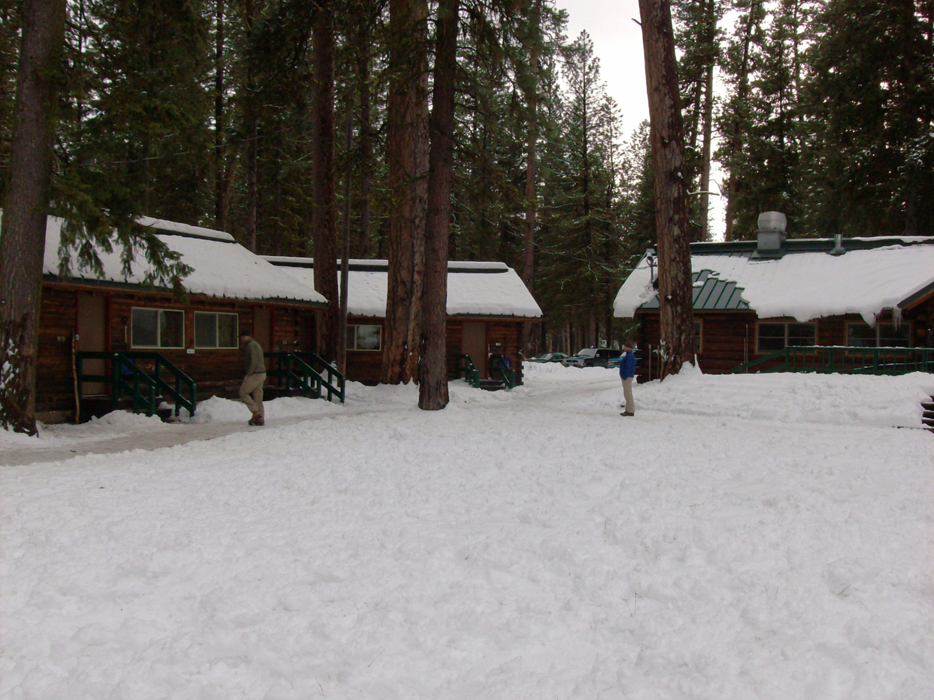

Slide 7
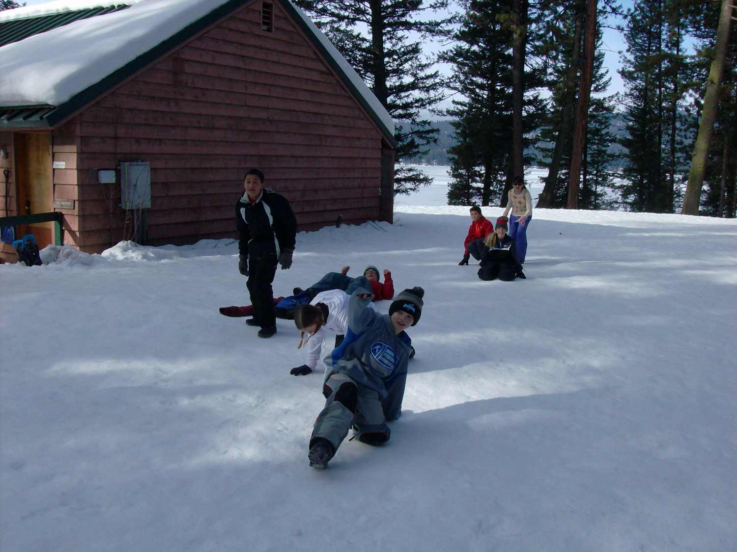

Slide 15
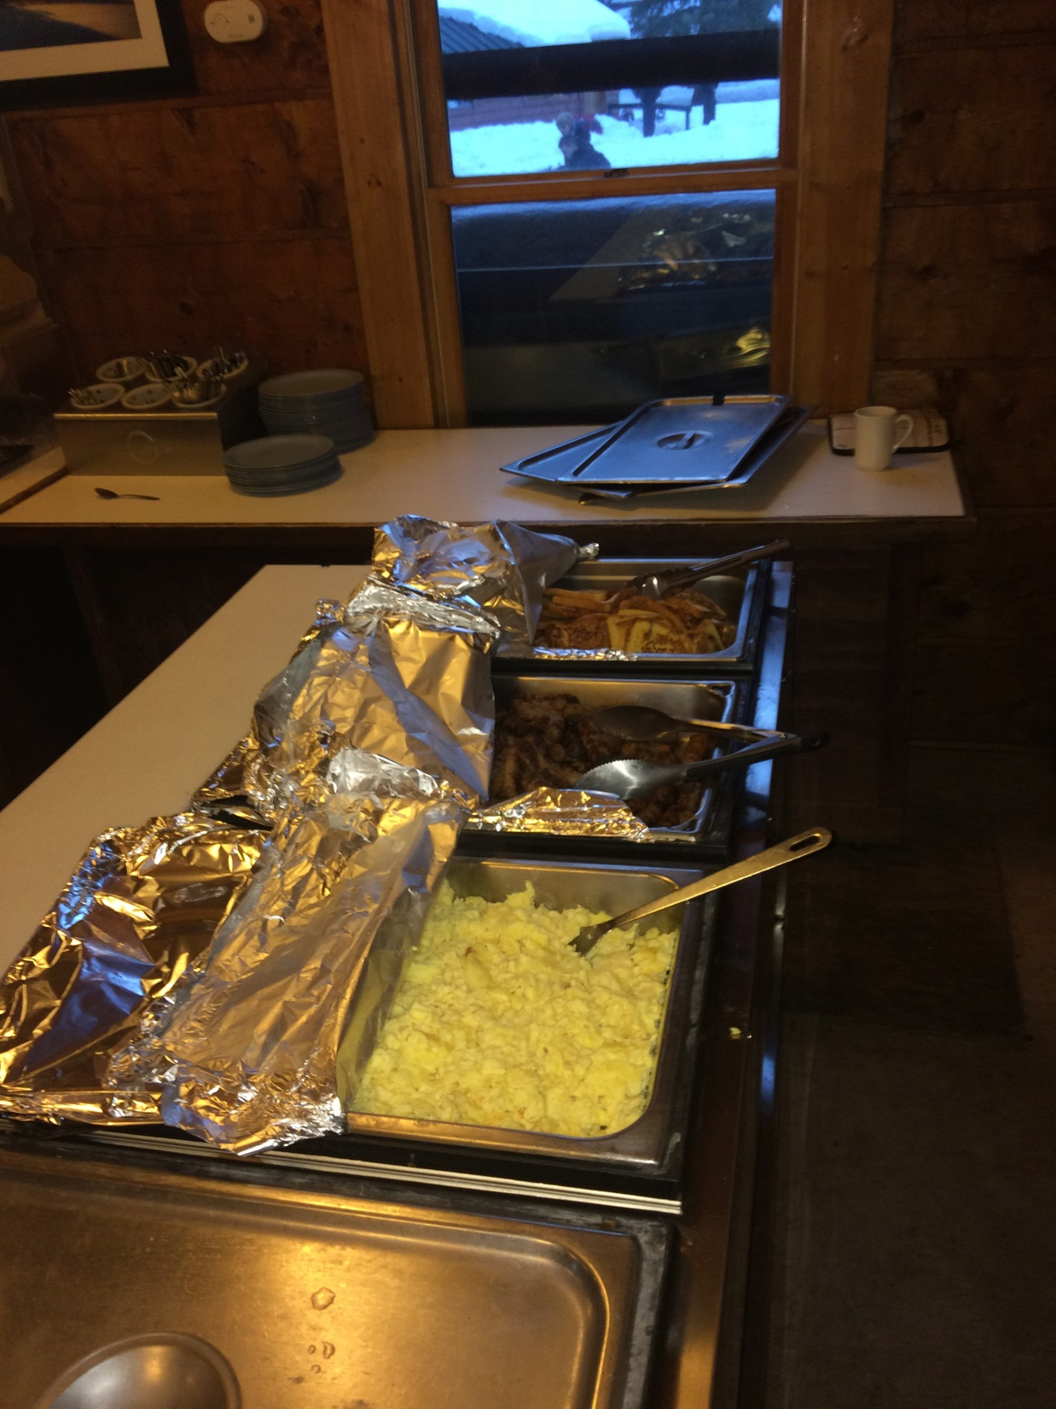

Slide 16
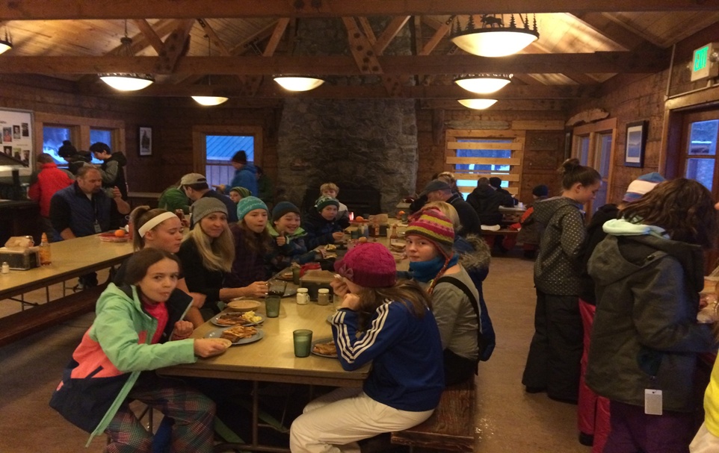

Slide 17
Cabins & Night Time at MOSS

Slide 18
Cabin Arrangements
Girl cabins are separate from boy cabins.
Cabins are in a “duplex” format with a connecting inside door.
6 students on each side of the cabin.
(Total of 12 students per cabin, 6 students on each side.)
At least one adult for each side of the cabin.
(2 adults per Cabin)
Cabin arrangements are made by the Lowell Staff.

Slide 22
A Few Reminders
What to Bring
See Attached List and/or Lowell Website
If you are interested in being a chaperone, complete the mini-application form. If you are selected, there will be an additional background check through the Boise School District.
Notes:
Transportation information (2017-2018):
$200 per bus up
$200 per bus down this includes the extra mileage.
A total of $400 for 1 bus.
If we decide to have the bus stop along the way, it will cost $1.84 every 5 minutes.
A bus can legally hold 71 students.
If we have 2 students to a seat, a bus can hold 48 students.
We need to keep in mind how many busses we need if we are going to also haul up the gear. Suggestion have parents take up the gear.
Requesting a bus, we must put it in as two trips. A bus going up to MOSS and a second trip a bus coming back from MOSS

Slide 23
A Few Reminders Continued
Finances:
Overall cost is $250.00 which includes transportation. This will be reduced through fundraisers.
You may start making payments now, either to Lowell PTSA or in a form of a donation to Boise School District Foundation (attn. Lowell MOSS)
There are partial scholarships available. Please notify Mr. Sica, D
Final payment is due January 11, 2016
Notes:
Transportation information (2017-2018):
$200 per bus up
$200 per bus down this includes the extra mileage.
A total of $400 for 1 bus.
If we decide to have the bus stop along the way, it will cost $1.84 every 5 minutes.
A bus can legally hold 71 students.
If we have 2 students to a seat, a bus can hold 48 students.
We need to keep in mind how many busses we need if we are going to also haul up the gear. Suggestion have parents take up the gear.
Requesting a bus, we must put it in as two trips. A bus going up to MOSS and a second trip a bus coming back from MOSS

Slide 24
Action Items
Save $ 250 for the cost of MOSS (This price will be reduced depending upon the level of fundraising.)
Payable to: BSD Foundation or Lowell PTSA.
Gather the necessary clothing items. *Waterproof Boots!
Please register your student for MOSS,
Link: https://moss.uidaho.edu/

Slide 25
Action Items Continued
Complete a medical release form.
Link: Fieldtrip Medical Authorization
Communicate to Lowell staff/nurse if your child has unique needs, e.g. medications, allergies, etc.
Complete a Chaperone Application Form if are interested in chaperoning at MOSS,
Link: https://moss.uidaho.edu/.

Slide 26
Contact Information
For additional questions after todays meeting please submit to:
6th.grade.moss.lowell@gmail.com

Slide 27
Q and A

Slide 28
Questions from 10/18/17
Can I take a shower every night? Yes, of course. Kids can shower in the morning or at night.
Can I pick who is in my cabin? Yes you can choose one friend to be in your cabin. Lowell staff will make cabin assignments.
What if I want to switch cabins once I’m already at MOSS. Can I switch? No
How many kids get to go MOSS? All kids are invited, and we hope all kids will go. However, if only 15 kids sign up we will still attend.
Will we be the only school at MOSS? No we will be sharing the camp with Cynthia Mann. We will be sharing orientation on day 1, free time, meal times, evening programs and morning free time. We will have our own sleeping spaces and field groups.

